Slide 1

Covid Criminals
PROJECT
Covid Criminals Team Presents

Slide 2

Welcome
Let’s visualize the relationship between COVID-19 cases and criminal activities in New York City!

Slide 3
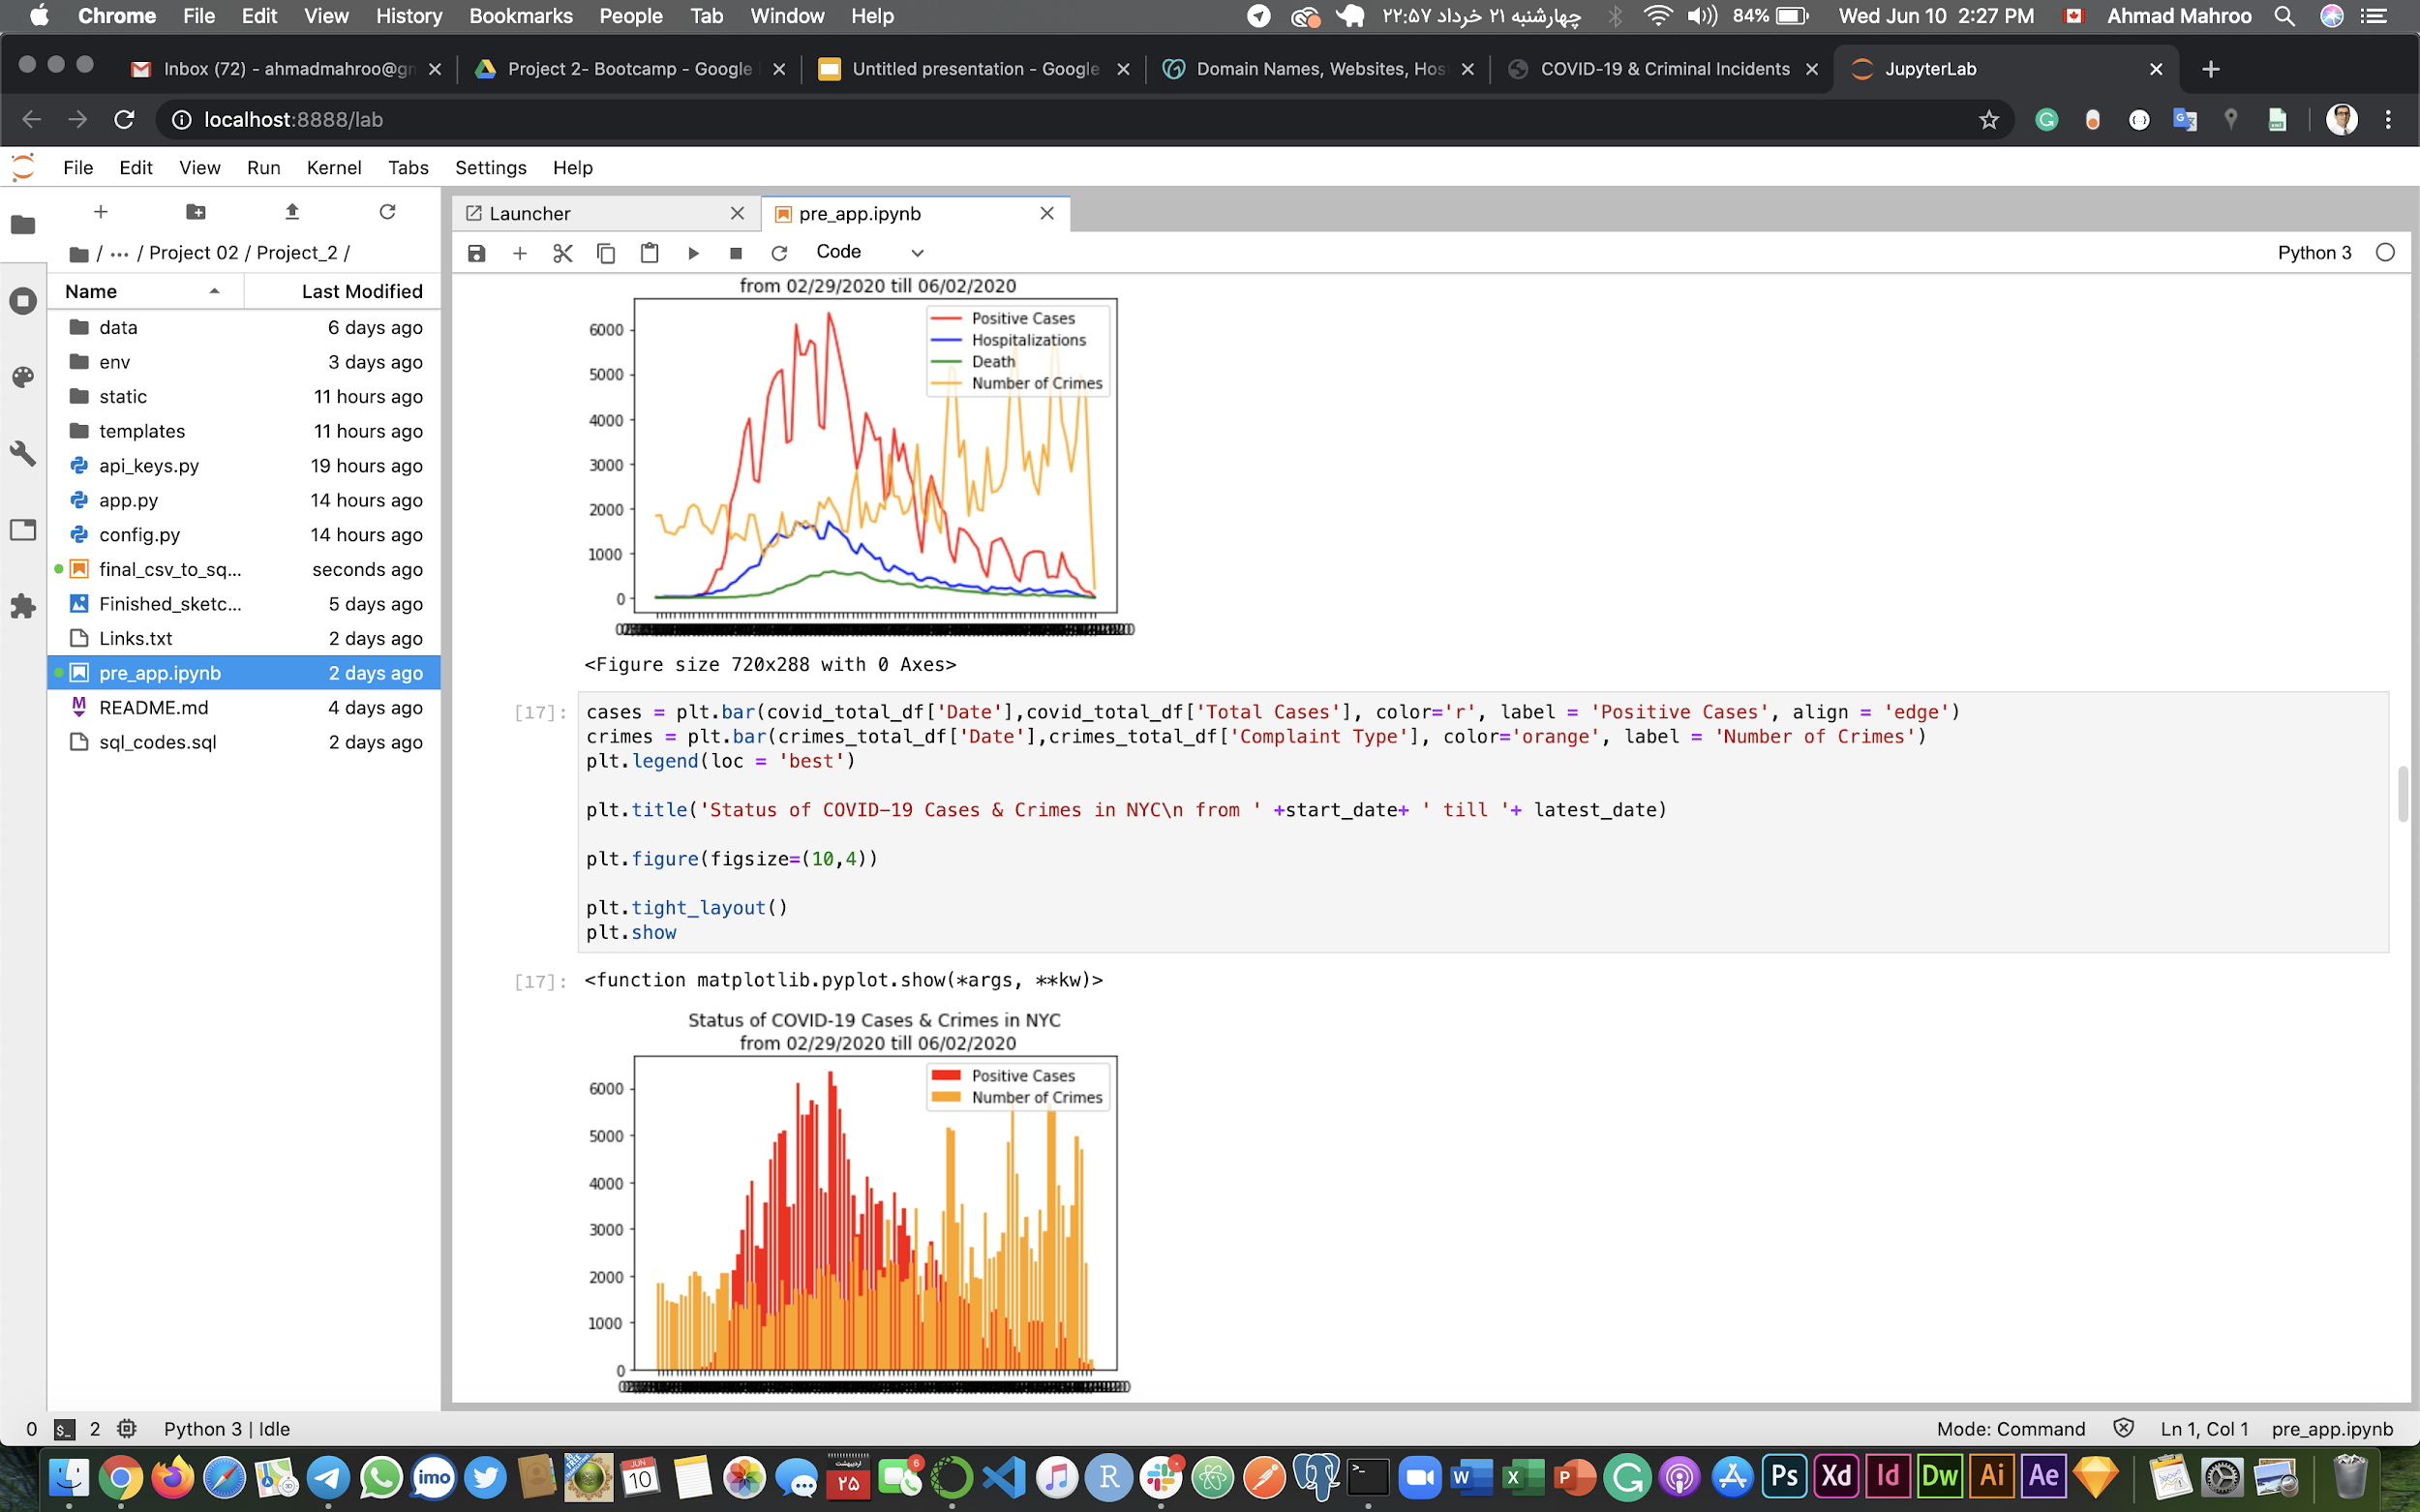
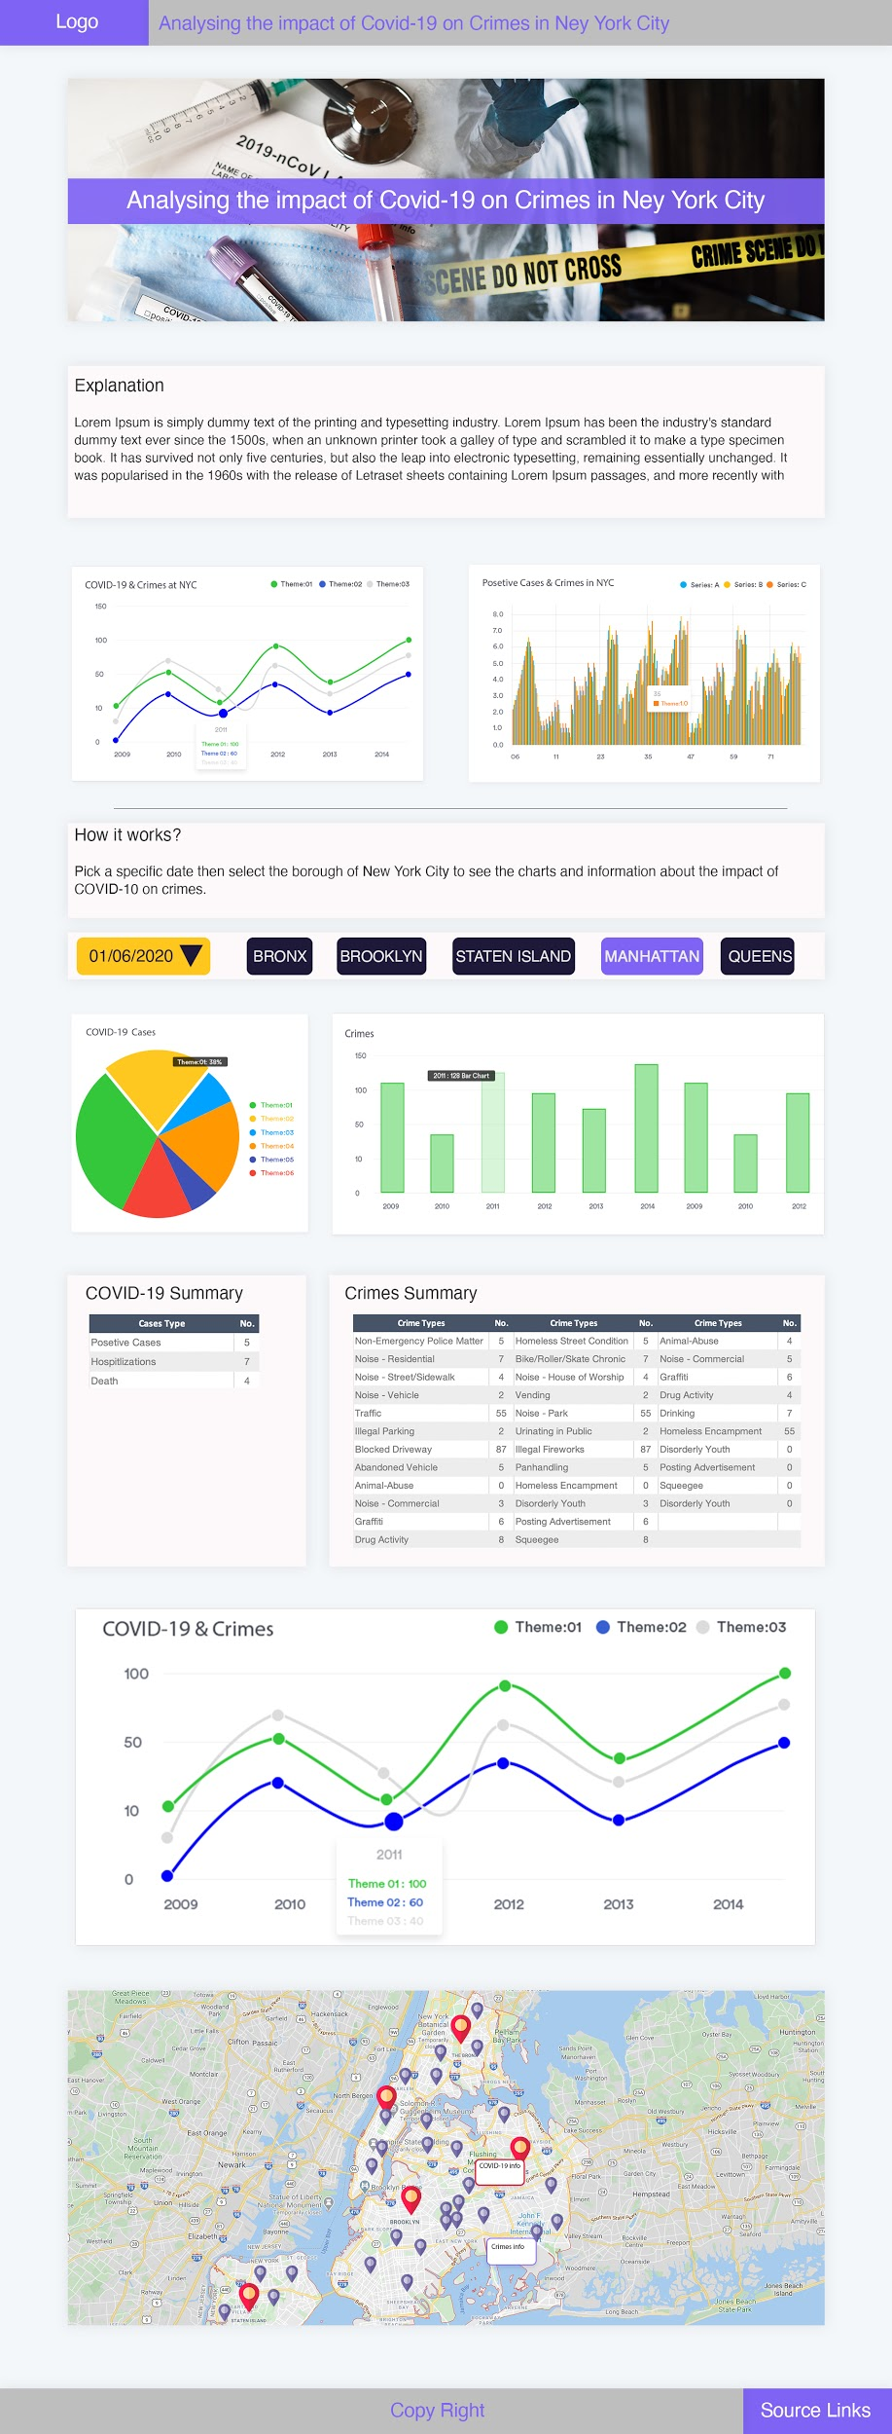
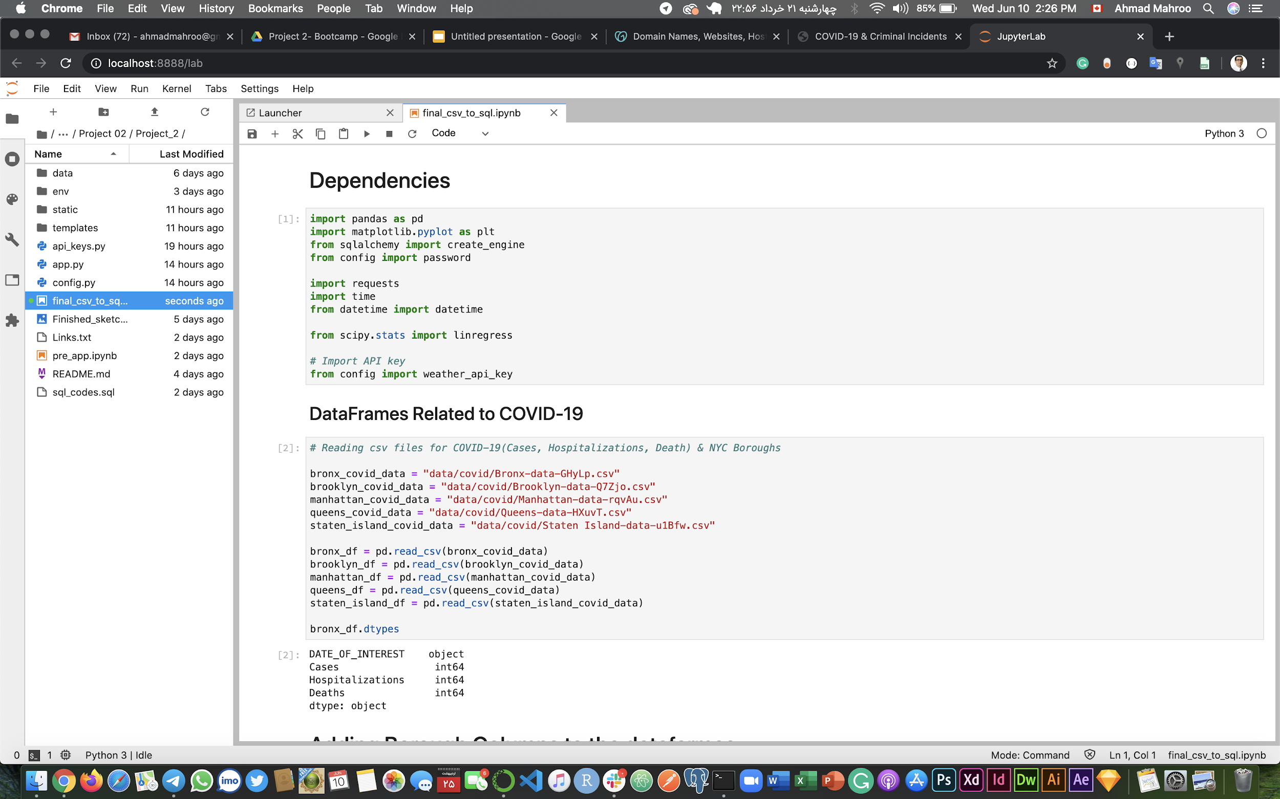




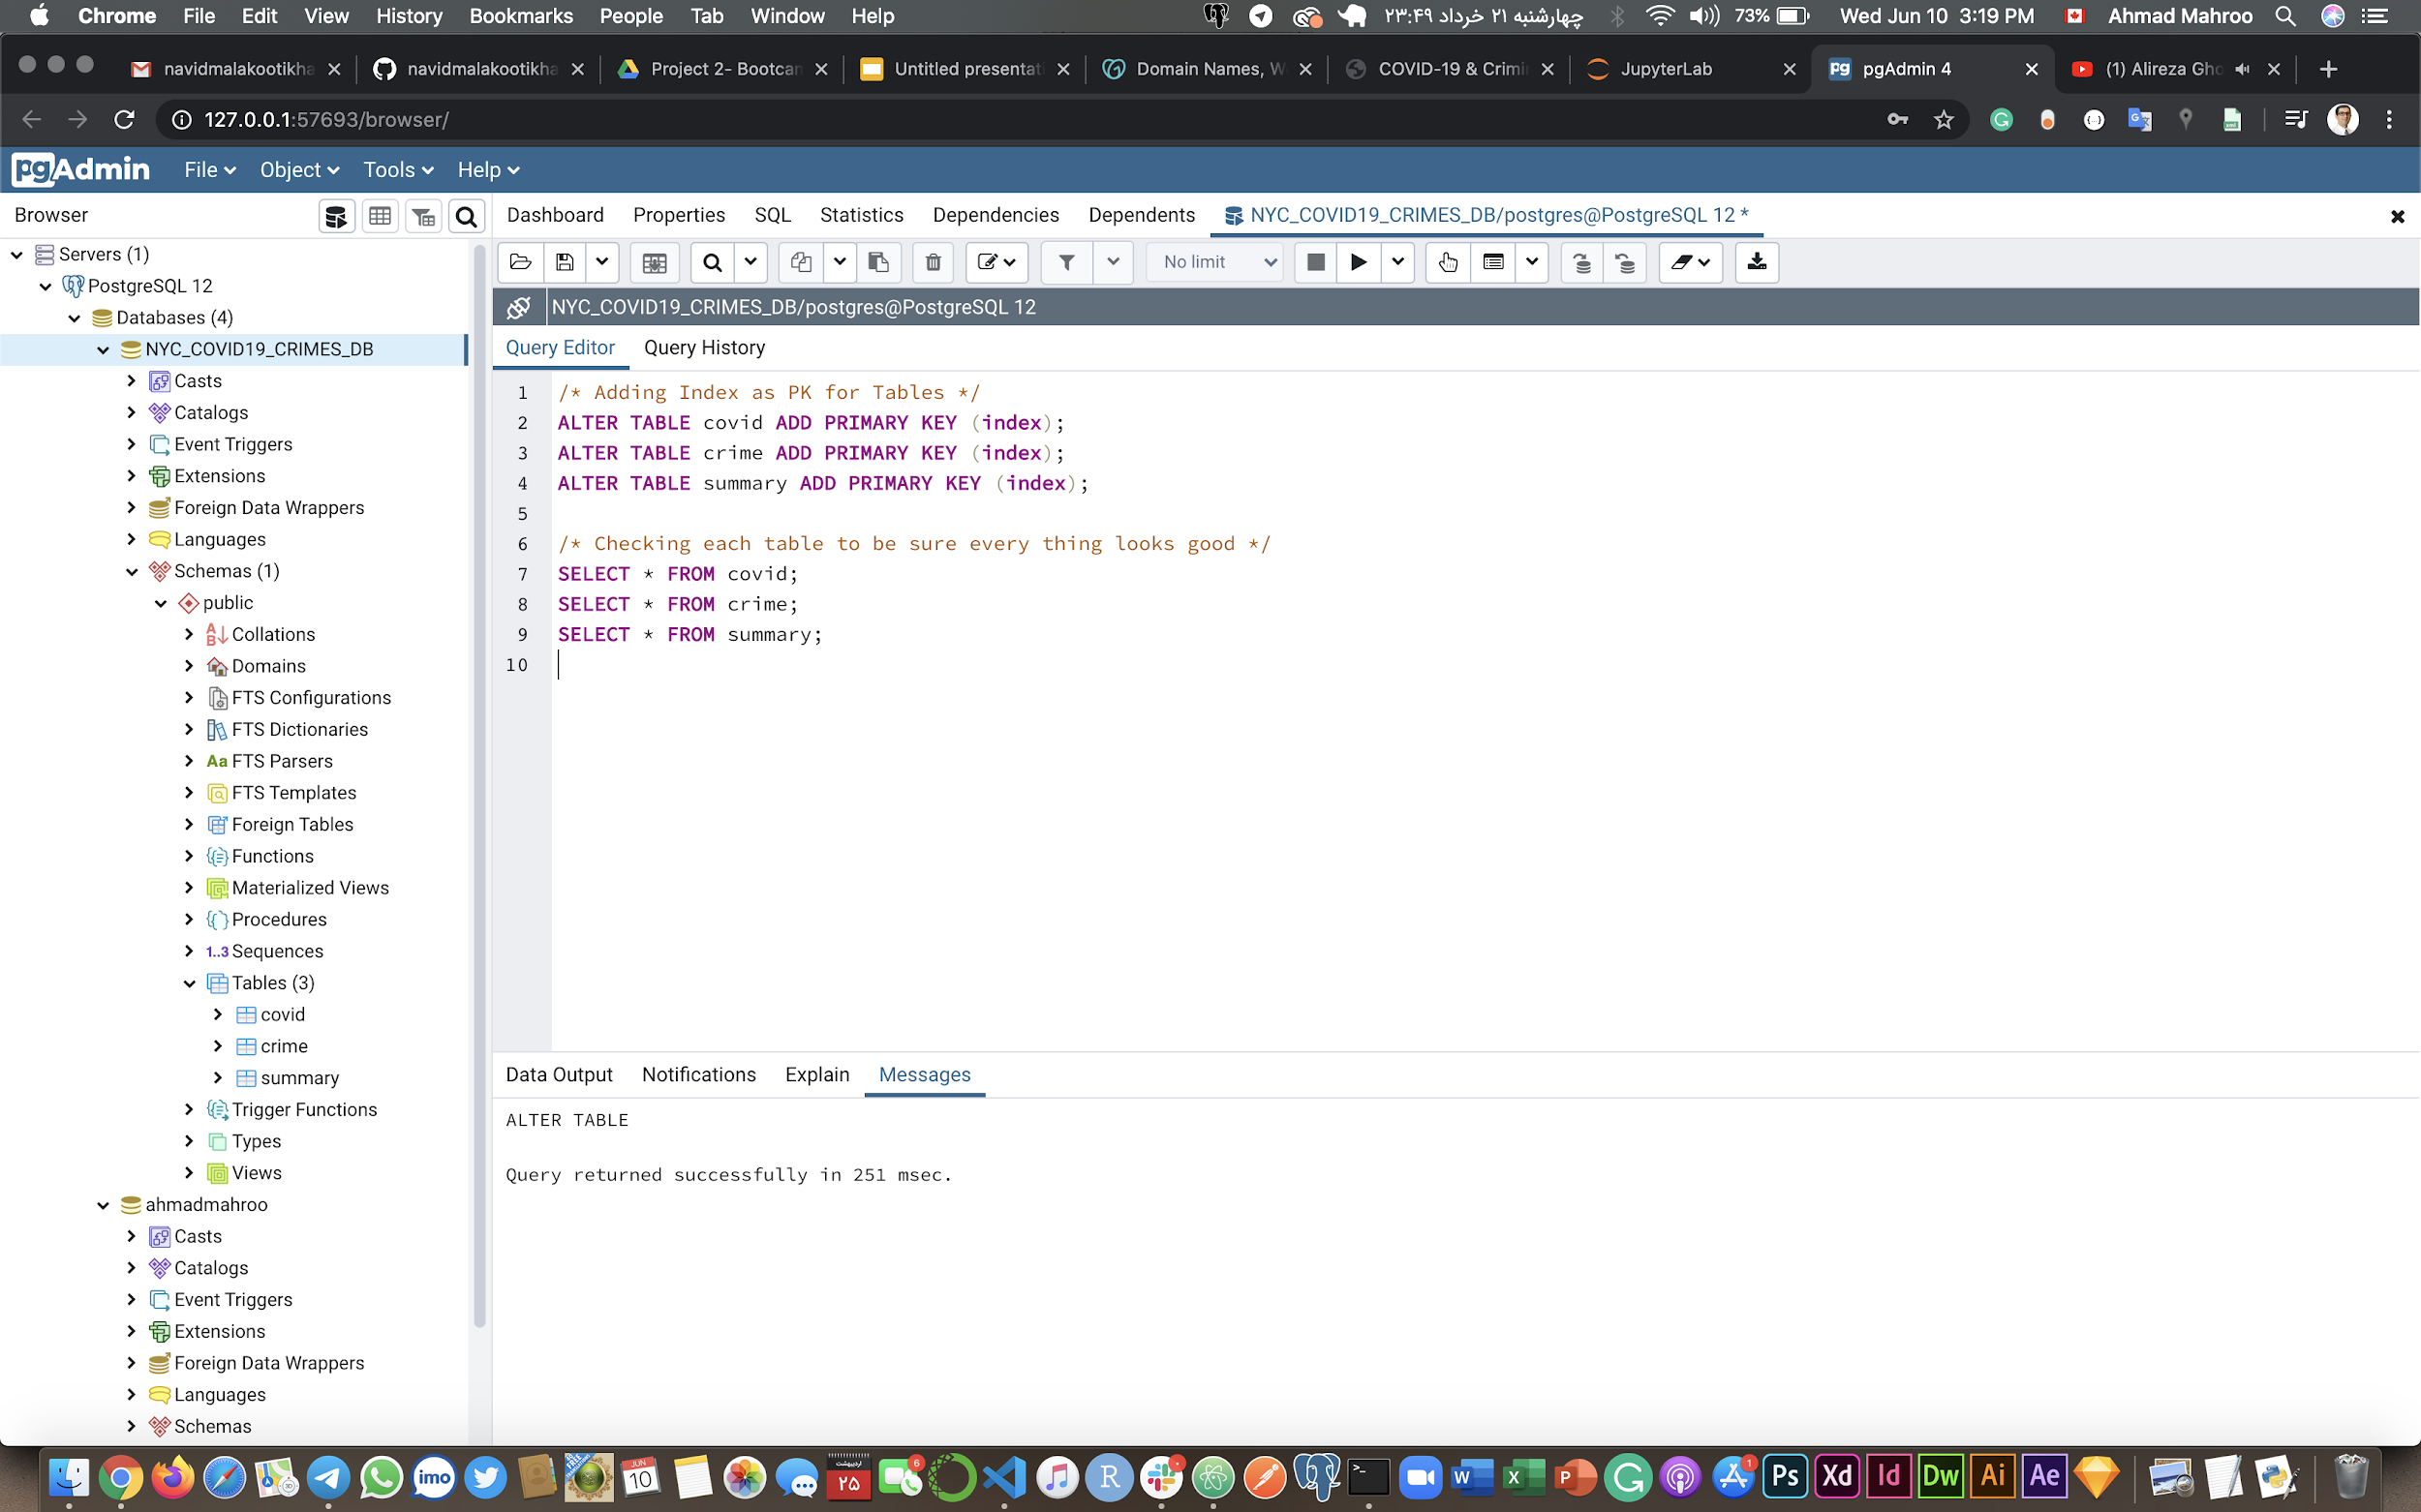
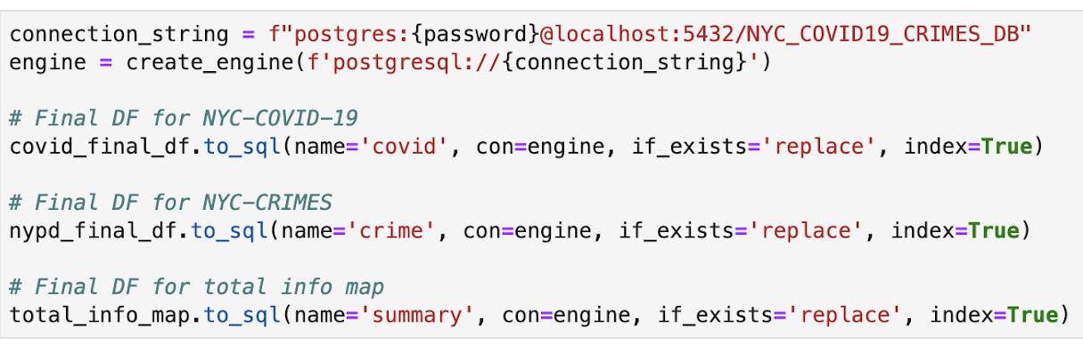





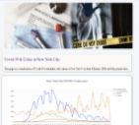
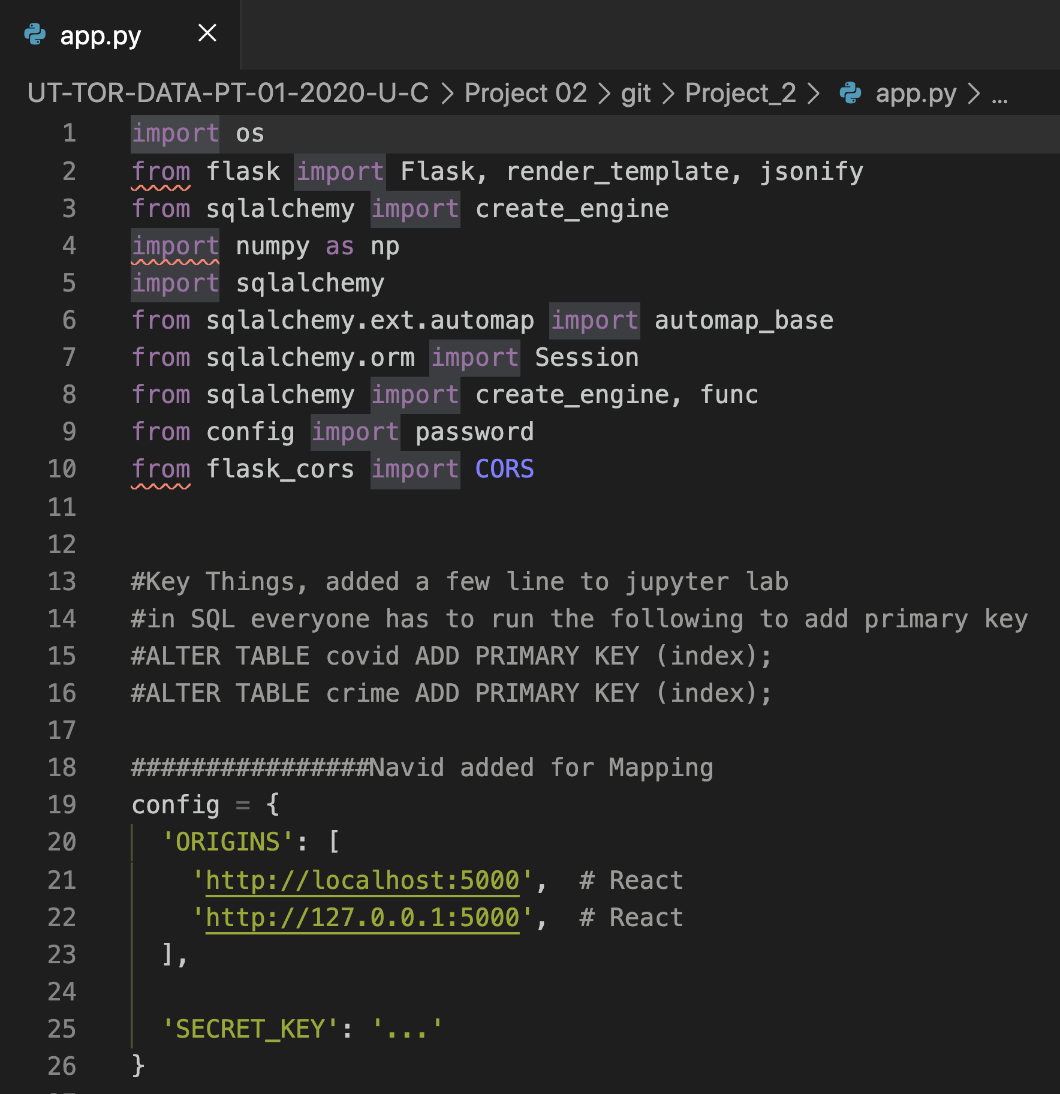
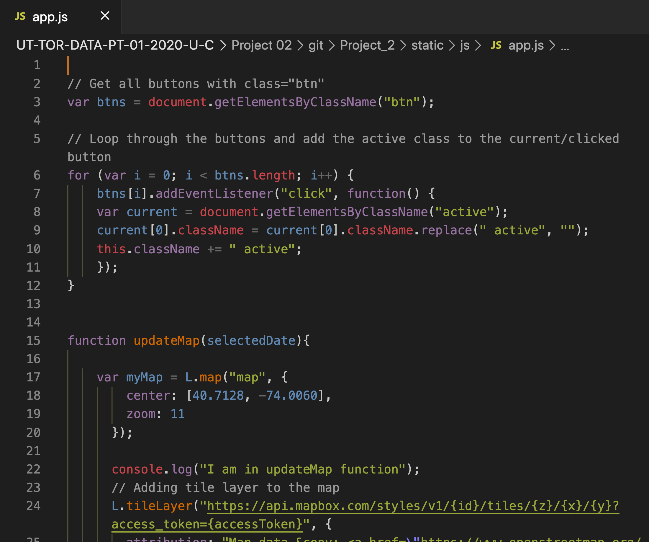
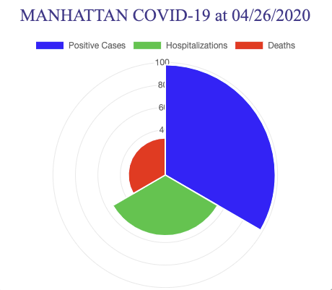
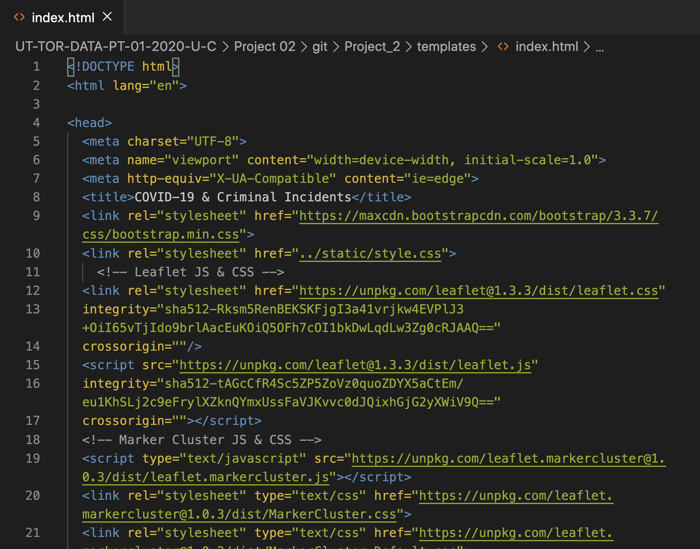
The project workflow in one glance
The Sources
Preliminary Analysis
Front-end planning
ETL
ETL
Flask App
Java Script, HTML, CSS
CHART.JS
Final Application

Slide 4
Datasets
Level of Difficulty
The Sources
All datasets are obtained from NYC open data sources.
All data were available in CSV and JSON formats.
NYC Covid-19 Dataset Link:
https://www1.nyc.gov/site/doh/covid/covid-19-data-boroughs.page
Why was it difficult?
It was challenging to find appropriate datasets that included all elements required such as Latitude and Longitude.
NYC Crimes Dataset Link:
https://data.cityofnewyork.us/Social-Services/NYPD/fjn5-bxwg

Slide 5
Jupyter
Level of Difficulty
Preliminary Analysis
What was done?
Read CSV files.
Removed unnecessary data.
Merged rows, tables and columns.
Grouped and aggregated.
Preliminary plotting.
Why?
Ensure our datasets are informative
Preliminary clean up to plan ETL
Initial plotting for early study

Slide 6
Design
Level of Difficulty
Front-end planning
What was done?
Based on our datasets and plots, the expected front-end was sketched in Adobe Photoshop.
Why?
Simplifying the output requirements, providing a layout for the wireframe of the HTML
To have clear roadmap for expected results

Slide 7
Jupyter
Level of Difficulty
ETL
What was done?
Jupyter app was created to extract, transform and load data into PostgreSQL.
Why?
Why was it difficult?
DataFrames were changed multiple times to obtain correct data structure and aggregated values.
Indexing for loading to SQL.
Data was required to be fed into SQL to further serve the front end application.

Slide 8
PostgreSQL
Level of Difficulty
ETL
What was done?
Database was created.
Data was loaded into SQL.
Ran scripts to assign primary keys.
Why?
To provide data to the Flask App.

Slide 9
Flask
Level of Difficulty
Flask App
What was done?
Googling and searching stack overflow to connect to Postgres
Created API routes
Provided JSON output data
Why?
Why was it difficult?
Provide a bridge between SQL data and the front-end. Flask was the data server.
Multiple API routes were created due to the large size of data and filtering requirements

Slide 10
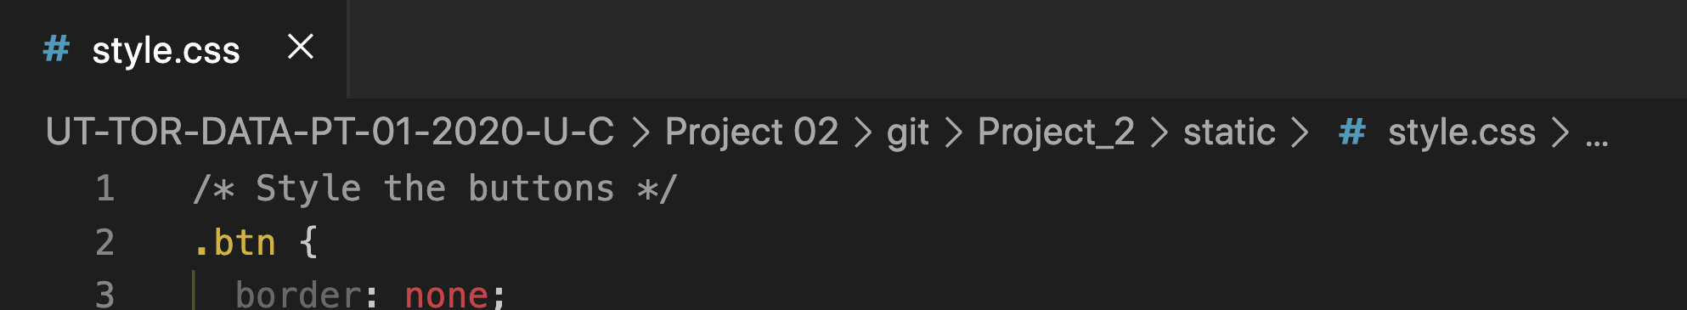
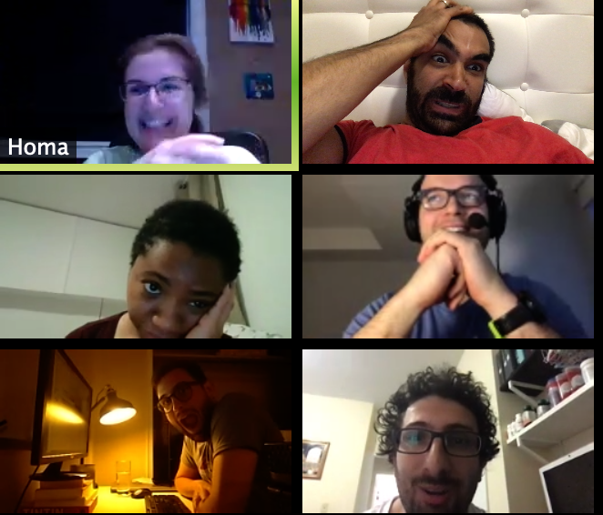
Front-end
Level of Difficulty
Java Script, HTML, CSS
What was done?
All JSON data called from Flask API using D3
Plots, charts, maps and dropdowns created
Leaflet, plotly, Geojson libraries utilized
Finalized styling via CSS
Why?
Dan said so!
Why was it difficult?
Beyond words!

Slide 11

Extra JS Library
Front end
Level of Difficulty
CHART.JS
https://chartjs.org
What was done?
Polar Area chart created to show proportions of COVID cases with a scale of value for context
Why?
Why was it difficult?
We had trouble deleting the initial data layer and updating the chart with new data
Created to explore the functionalities of another JS library

Slide 12
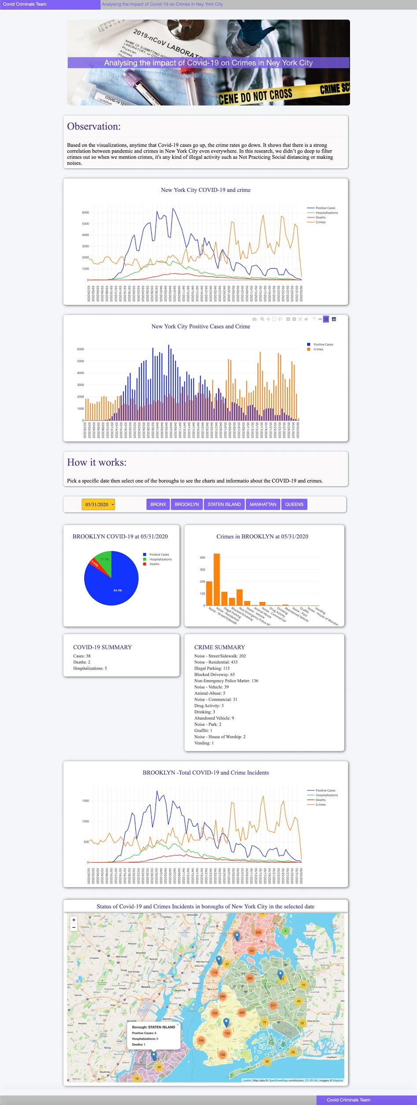

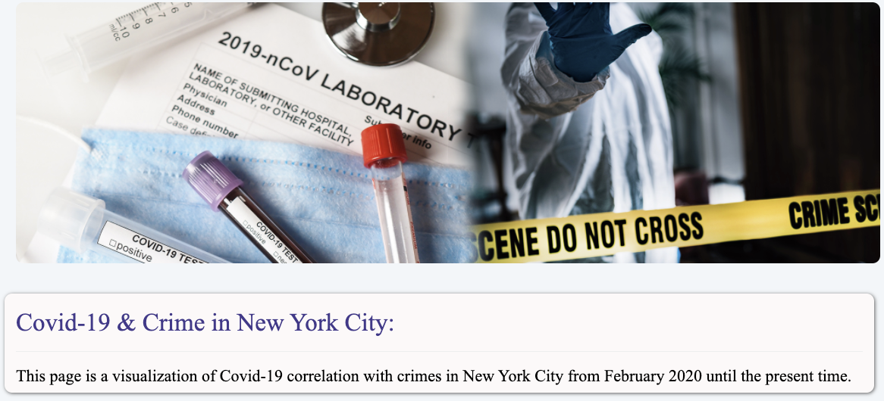
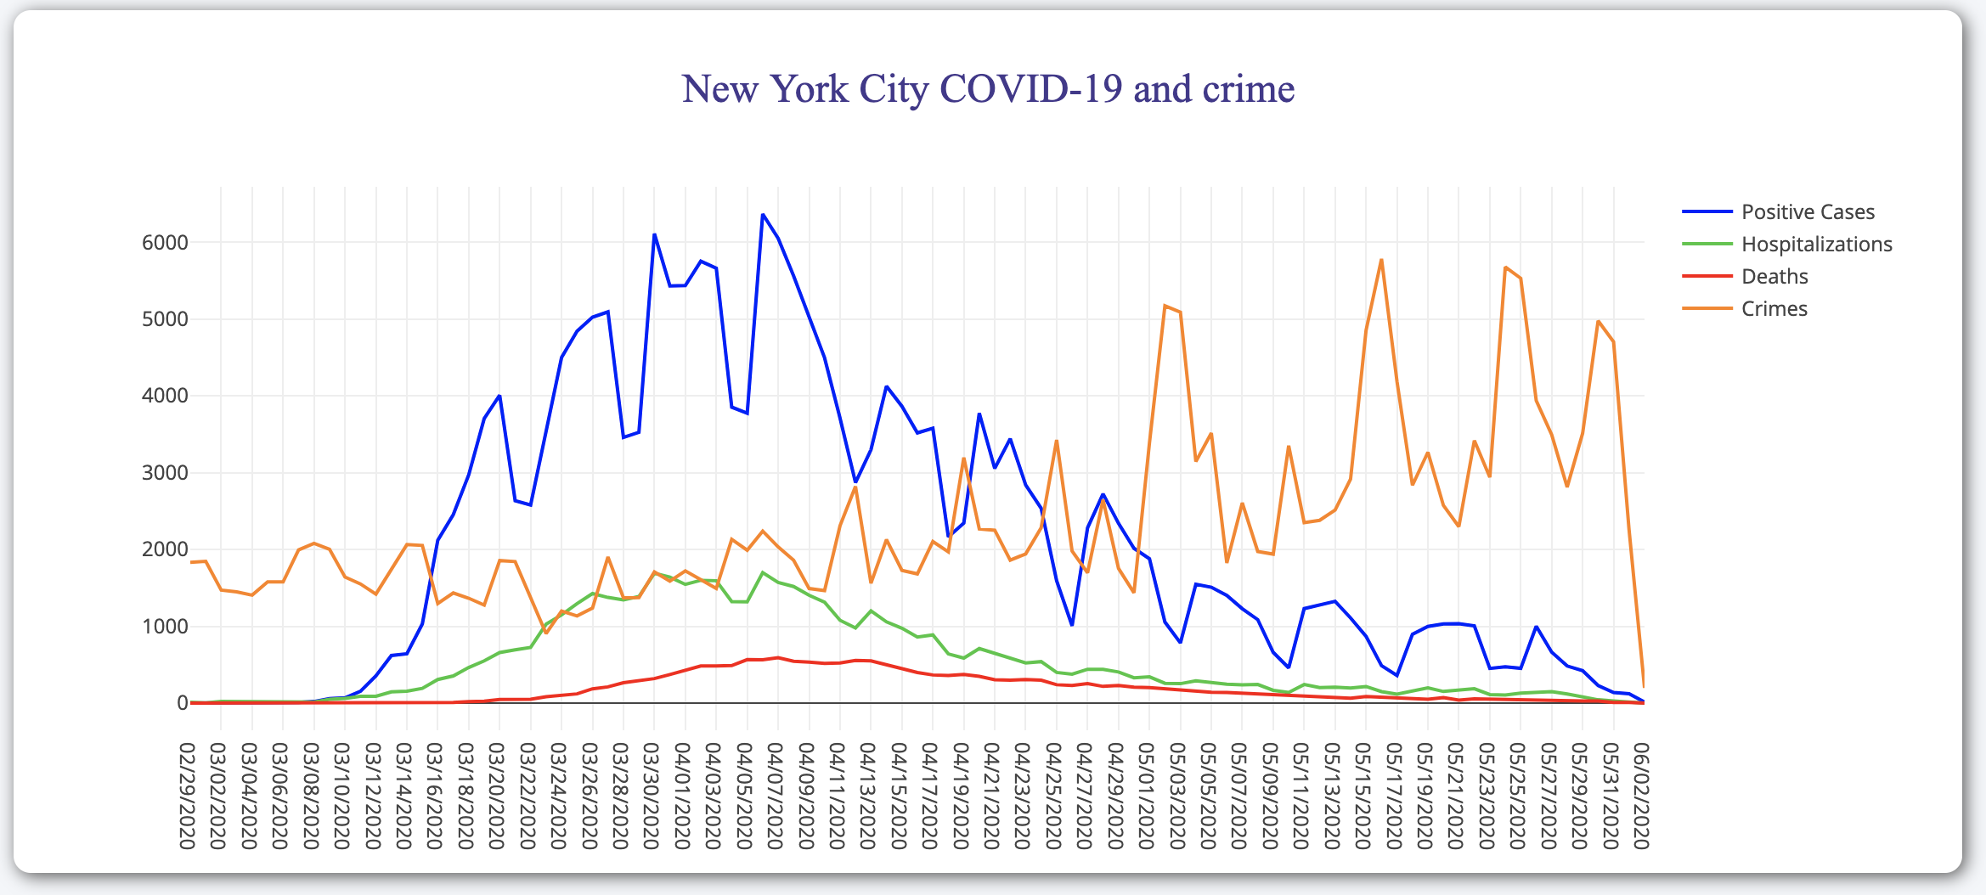
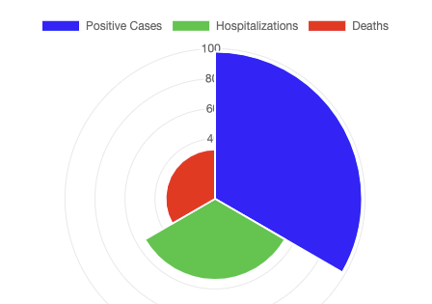
Final Application
High Covid-19
Low Crime
High Crime
Low Covid-19
Let’s see the project

Slide 13

Discussion Panel
Thank you!

